Slide 1

ONLINE LIBRARY MANAGEMENT SYSTEM
Created By:
Roshan Kumar Patro
USN:1RN16IS081
Sailesh Khandelwal
USN:1RN16IS083
Guide:
Mrs. Hema N
Faculty Incharge:
Mrs. Kusuma S

Slide 2
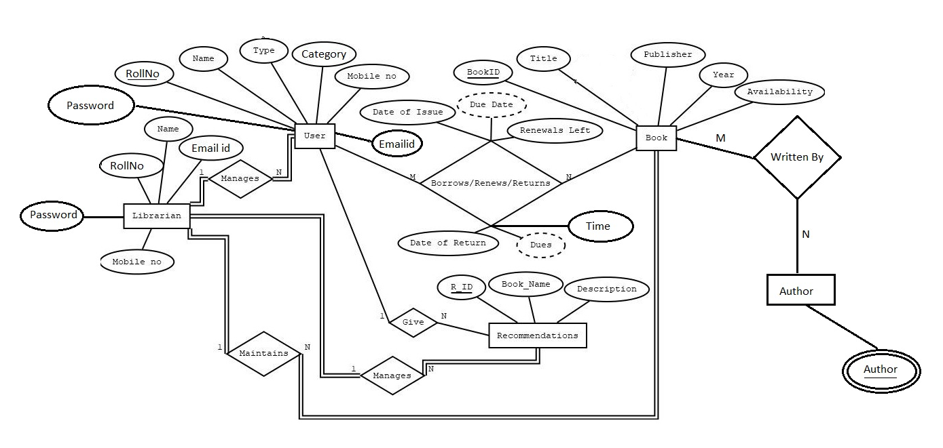
ENTITY RELATIONSHIP DIAGRAM

Slide 3
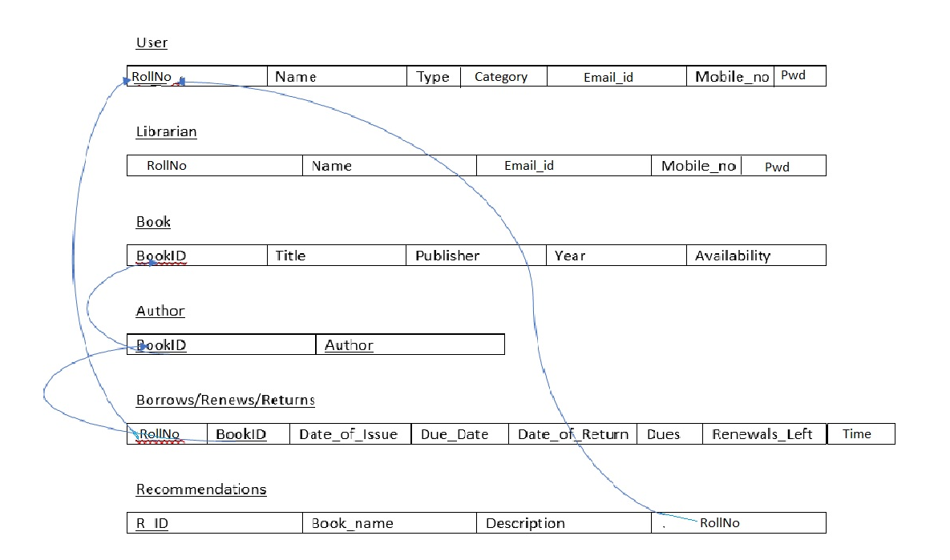
RELATIONAL- SCHEMA DIAGRAM

Slide 4
Software Requirements
1. Database - MYSQL is used as database as it easy to maintain and retrieve records by simple queries which are in English language which are easy to understand and easy to write. 2. Development tools and Programming language- HTML is used to write the whole code and develop webpages with CSS, JavaScript for styling work, PHP is used for backend development.
Hardware Requirements
i. Intel core i3 and above is required for a stable experience and fast retrieval of data. ii. 2 GB RAM is required as it will provide fast reading and writing capabilities which will in turn result in better performance time.

Slide 5
APPLICATIONS OF ONLINE LIBRARY MANAGEMENT
This project provides a friendly environment to maintain the details of books and library members.
This project is for automation of library works.
It provides following facilities to
Librarian:
Can enter details related to a particular book.
Can respond to issue/return/renew requests and process recommendations from members.
Can also respond to members messages.
2. Member:
i. Can request for issue/return/renew and check for any existing fine
by asking the librarian.
ii. Can keep track of all the books issued and their respective due dates.
iii. Can recommend new books to the Librarian.

Slide 6
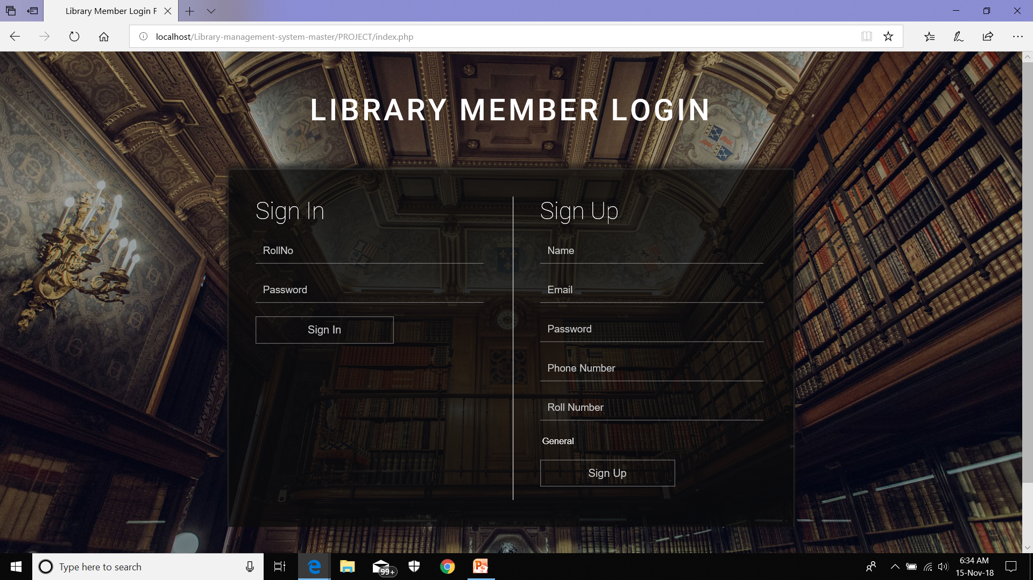
SNAPSHOTS: 1. LOGIN PAGE:

Slide 7
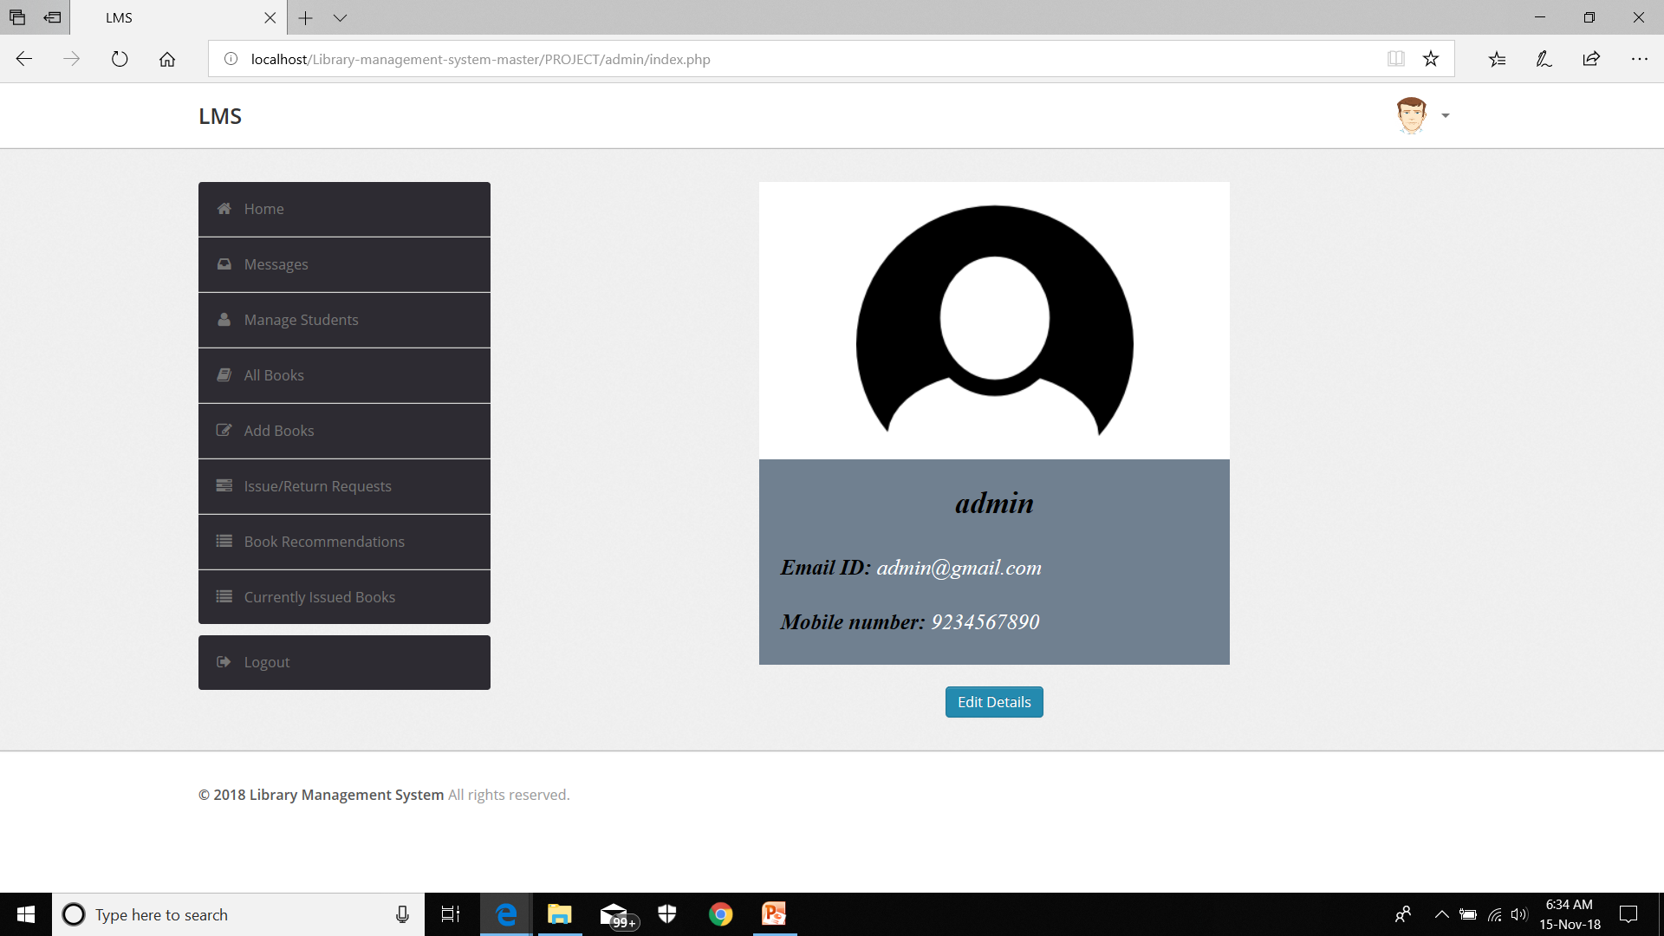
2. ADMIN-HOME PAGE:

Slide 8
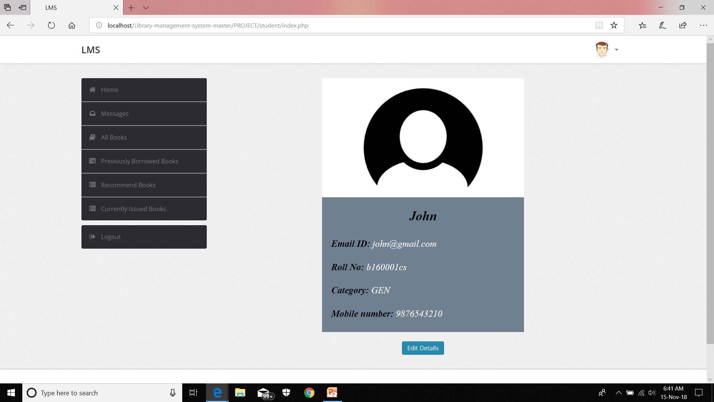
3.USER-HOME PAGE:

Slide 9
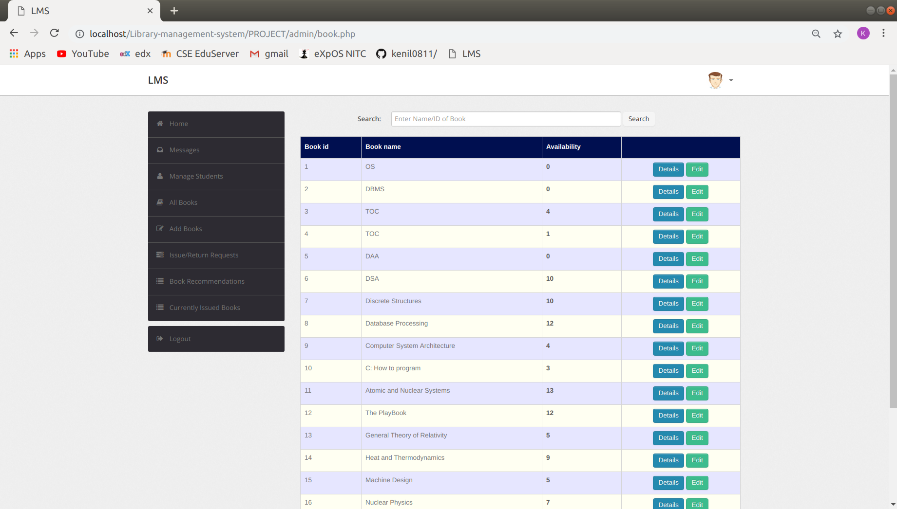
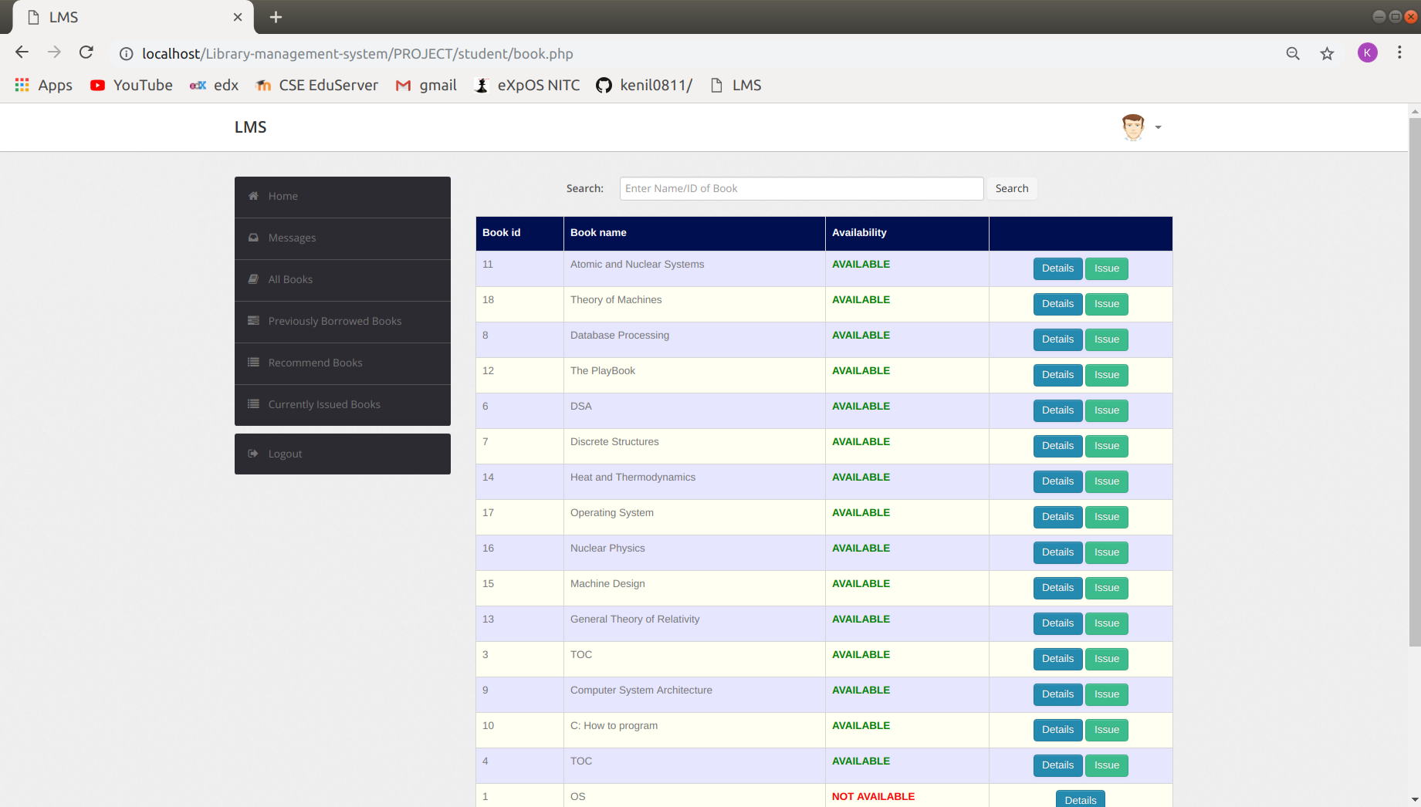
SNAPSHOTS:

Slide 10
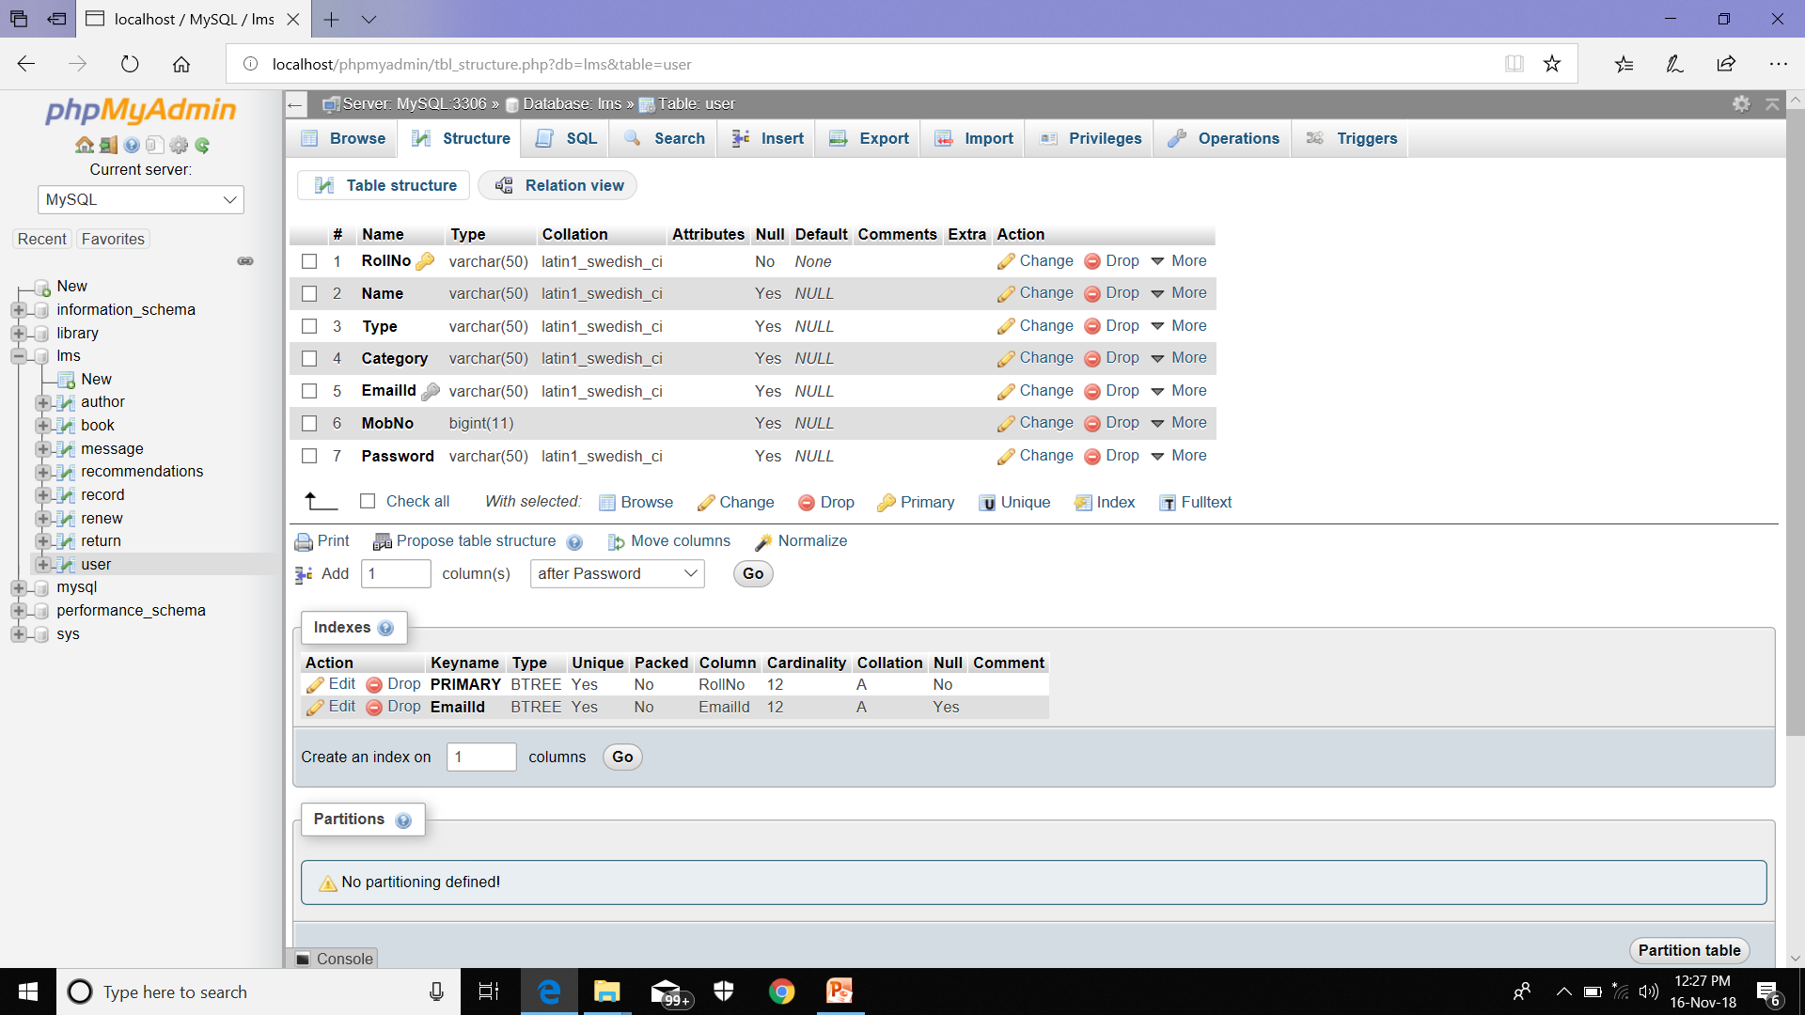
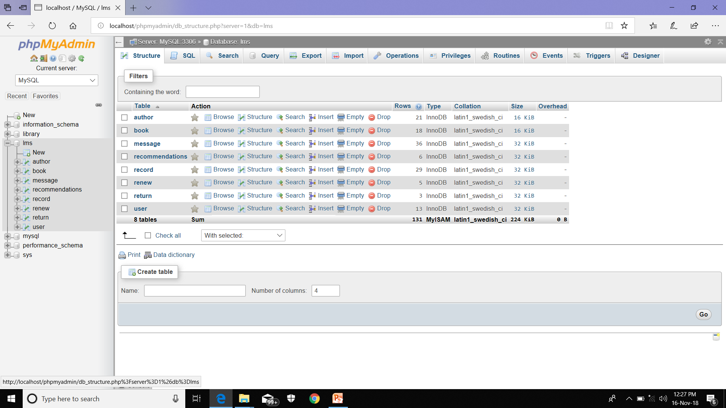
DATABASE:

Slide 11
CONCLUSIONS
From a proper analysis of positive points and constraints on the programs, it can be safely concluded that the product is a efficient alternative to manual library management techniques . This application is working properly and meeting to the pre-defined user requirements. This component can be easily used in many other platforms.

Slide 12
FUTURE ENHANCEMENTS
This application can be easily implemented under various situations. We can add new features as and when we require. Reusability is possible as and when require in this application. There is flexibility in the program.
Key Software Scopes:
EXTENSIBILITY
REUSABILITY
UNDERSTANDABILITY
COST-EFFECTIVE

Slide 13
REFERENCES
http://www.w3schools.com/html/html_intro.asp http://www.w3schools.com/css/css_background.asp http://www.w3schools.com/js/js_datatypes.asp http://www.w3schools.com/sql/sql_insert.asp http://www.w3schools.com/sql/sql_update.asp http://www.w3schools.com/php/php_forms.asp
Fundamentals of software engineering by Rajib mall
Web development and application development by Ivan Byross
Fundamentals of Database System by Elmasri

